Slide 1
Database Presentation

Slide 2
Cash ‘&’ Carry

Slide 3
Project_Info
Super store in a retail environment, a super store is a large retailer who stocks and sells a wide variety of merchandise including utilities, food items, appliances and cosmetics and general supplies. A number of employees manages the store. This project focuses on the purchase and sales of super store’s products that how we manage to control and hold all the tasks and manage our progress and performance. We also retrieve data against profit and loss

Slide 4
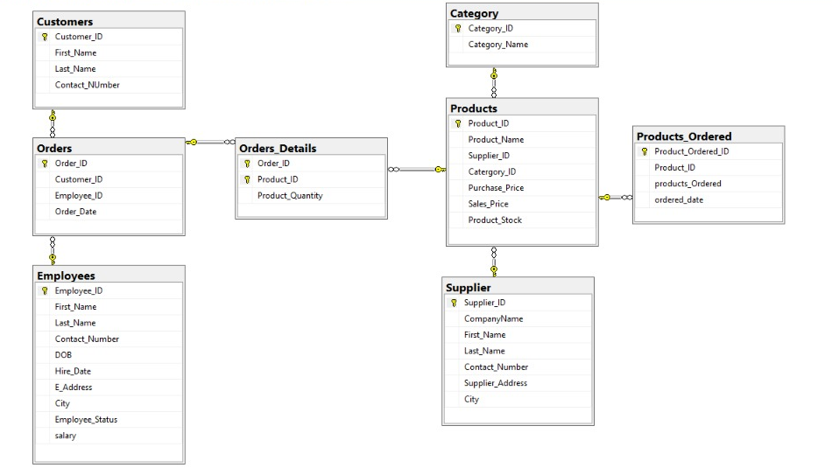

Slide 5
Project analysis slide 2
Project Analysis
Products
Orders
Entities
Category
Supplier
Employees
Customer

Slide 6
Project analysis slide 3
Project Analysis
Products
Employees
Customers
Supplier
Category
INSERT INTO Products (Product_Name, Supplier_ID, Catergory_ID, Purchase_Price,
Sales_Price, Product_Stock)
VALUES ('Milk’, 1, 1, 100, 150, 105),
INSERT INTO Employees (First_Name, Last_Name, Contact_Number, DOB, salary, Hire_Date, Employee_Status, E_Address, City)
VALUES ('Shahbaz', 'Ansar', 345347, '1988-05-18', 18000, '2019-03-08', 'Expired', 'Kamahan', 'Sialkot'),
INSERT INTO Customers (First_Name, Last_Name, Contact_NUmber)
VALUES ('fahad', 'Ashfaq', 76343456),
INSERT INTO Supplier (CompanyName, First_Name, Last_Name, Contact_Number, Supplier_Address, City)
VALUES ('Nestle', 'Usman', 'Umar', 876543, 'Defence', 'Karachi'),
INSERT INTO Category (Category_Name)
VALUES ('Food Items'),

Slide 7
Project analysis slide 3
Project Analysis
Orders
Orders_Details
Products_Ordered
Products
INSERT INTO Orders (Customer_ID, Employee_ID)
VALUES (1, 2 ),
INSERT INTO Orders_Details(Order_ID, Product_ID, Product_Quantity)
VALUES (1, 1, 4),
INSERT INTO Products_Ordered (Product_ID, products_Ordered)
Values (1,5),

Slide 8
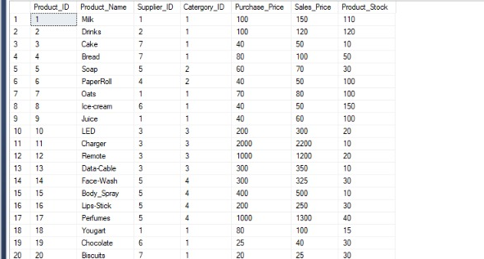
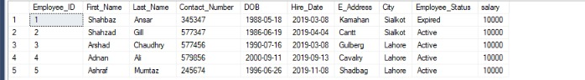
Project analysis slide 3
Project Analysis
Select*from Products
Employees
Orders
Select*from Employee

Slide 9
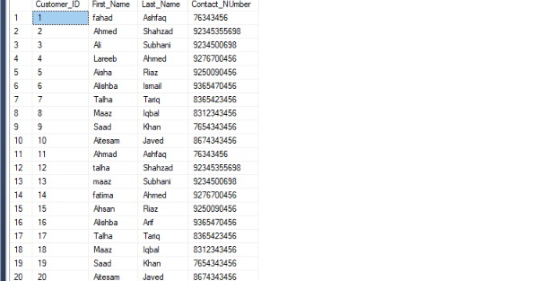
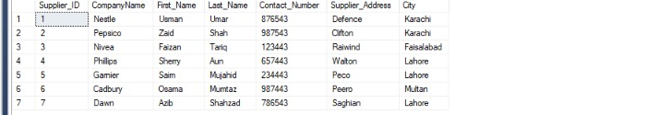
Project analysis slide 3
Project Analysis
Select*from Customers
Employees
Orders
Select*from Supplier

Slide 10
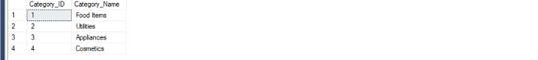
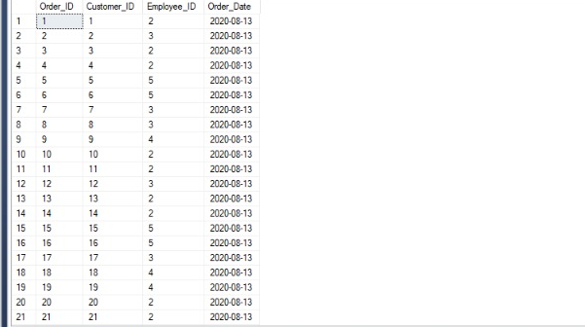
Project analysis slide 3
Project Analysis
Select*from Category
Employees
Orders
Select*from Orders

Slide 11
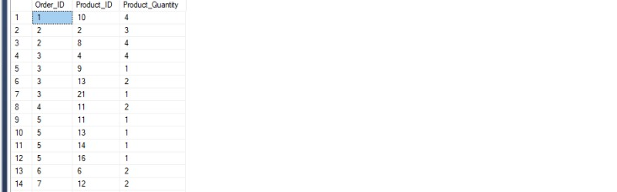
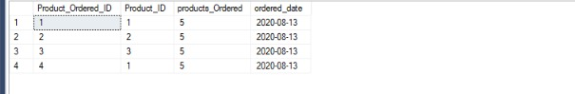
Project analysis slide 3
Project Analysis
Select*from Order_Details
Employees
Orders
Select*from Products_Ordered

Slide 12
Project analysis slide 8
Project Analysis
Create Indexes:
create nonclustered index index_employee
on Employees(City)
create nonclustered index index_customers
on Customers(First_Name)
create nonclustered index index_Products
on Products(Product_Name)
create nonclustered index index_Orders
on Orders(Customer_ID)
create nonclustered index index_Products_Ordered
on Products_Ordered(Product_ID, ordered_date)
create nonclustered index index_supplier
on Supplier(CompanyName)

Slide 13
Project analysis slide 8
Project Analysis
create view Bill_details
as
select Employee_ID,dbo.Orders.Order_ID,Customer_ID,Product_Name, Sales_Price, Product_quantity from Orders_Details
inner join Products on Products.Product_ID = Orders_Details.Product_ID
inner join Orders on Orders.Order_ID = Orders_Details.Order_ID
declare @getCID int
select @getCID=1
select Employee_ID,Order_ID,Customer_ID,Product_Name,Sales_Price as Product_Price, Product_quantity ,Sales_Price * Product_quantity as total
from Bill_details WHERE Customer_ID=@getCID
Select sum(Sales_Price * Product_quantity) as Payable_Amount
from Bill_details group by Customer_ID having Customer_ID=@getCID

Slide 14
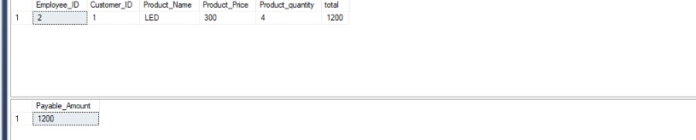
Project analysis slide 3
Project Analysis
Bill_details
Employees
Orders
Select*from Orders

Slide 15
Project analysis slide 8
Project Analysis
CREATE view View_Stock
as
Select Product_Id,Product_Name, Product_Stock, CompanyName from Products
inner join Supplier on Supplier.Supplier_ID=Products.Supplier_ID
select * from View_Stock where Product_Stock<50
create view Employee_Salary
as
Select First_Name,Last_Name,salary, Employee_Status from Employees
select * from Employee_Salaray where Employee_Status='Active'

Slide 16
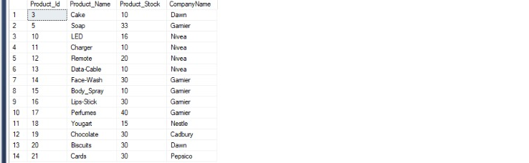
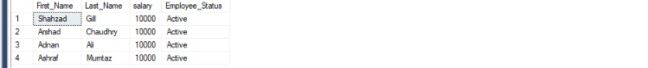
Project analysis slide 3
Project Analysis
View_Stock
Employees
Orders
Select*from Orders
Employee_Salaray

Slide 17
Project analysis slide 8
Project Analysis
create view Monthly_Sale
as
select Product_Name,Sales_Price, Product_quantity,Order_Date from Orders_Details
inner join Products on Products.Product_ID = Orders_Details.Product_ID
inner join Orders on Orders.Order_ID = Orders_Details.Order_ID
declare @getMonth int
select @getMonth=8
Select Product_Name ,sum(Product_Quantity) as total_Products,sum(Product_Quantity * Sales_price) as total_amount
from Monthly_Sale where MONTH(Order_Date )= @getMonth group by Product_name
Select sum(Product_Quantity * Sales_price) as total_Sale_amount
from Monthly_Sale where MONTH(Order_Date )= @getMonth

Slide 18
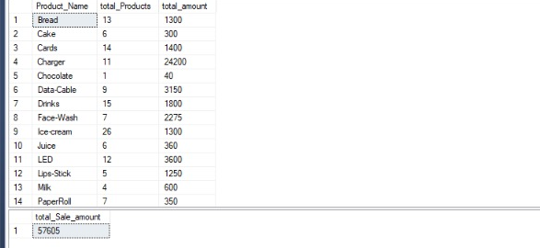
Project analysis slide 3
Project Analysis
Monthly_Sale
Employees
Orders
Select*from Orders

Slide 19
Project analysis slide 8
Project Analysis
create view Purchase_Products
as
select Product_Name, Purchase_Price, products_Ordered, ordered_date as Purchase_Date from Products
inner join Products_Ordered on Products_Ordered.Product_ID=Products.Product_ID
declare @date as int
select @date=13
select Product_Name, Purchase_Price, products_Ordered as Products_Quantity, Purchase_Date from Purchase_Products
where DAY(Purchase_Date)=@date
select sum(purchase_price*products_Ordered) as Purchasing_Bill from Purchase_Products where DAY(Purchase_Date)=@date

Slide 20
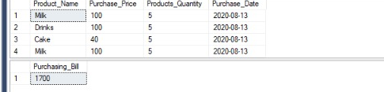
Project analysis slide 3
Project Analysis
Purchase_Products
Orders
Select*from Orders

Slide 21
Project analysis slide 8
Project Analysis
Create trigger bill_trigger
on Orders_Details
for Insert
as
declare @CID as int;
declare @OID as int;
Select @OID=Order_ID from inserted;
select @CID=(select Customer_ID from Orders where Order_ID=@OID) from inserted;
begin
select Employee_ID,Order_ID,Customer_ID,Product_Name,Sales_Price as Product_Price, Product_quantity ,Sales_Price * Product_quantity as total
from Bill_details where Customer_ID=@CID
Select sum (Sales_Price * Product_quantity) as Payable_Amount
from Bill_details group by Customer_ID having Customer_ID=@CID
end

Slide 22
Project analysis slide 8
Project Analysis
create trigger update_stock_On_sale
on Orders_Details
for Insert
as
declare @PID as int;
declare @qty as int;
select @qty=Product_Quantity from inserted;
select @PID=Product_ID from inserted
begin
update Products
set Product_Stock= Product_Stock-@qty where Product_ID =@PID
end

Slide 23
Project analysis slide 8
Project Analysis
CREATE trigger update_stock_On_purchase
on Products_Ordered
for Insert
as
declare @PID as int;
declare @qty as int;
select @PID=Product_ID from inserted
select @qty= products_Ordered from inserted
begin
update Products
set Product_Stock= Product_Stock+@qty where Product_ID=@PID;
end

Slide 24
Project analysis slide 8
Project Analysis
create Procedure cal_Profit
@month as int,
@result int output
as
declare @E_salary int ;
declare @t_sale as int ;
declare @t_purchase as int ;
begin
select @E_salary= (select sum(salary) from Employees where Employee_Status='Active')
Select @t_purchase= (select sum(purchase_price*products_Ordered) as Purchasing_Bill from Purchase_Products where Month(Purchase_Date)=@month)
select @t_sale = (Select sum(Product_Quantity * Sales_price) as total_Sale_amount from Monthly_Sale where MONTH(Order_Date )=@month )

Slide 25
Project analysis slide 8
Project Analysis
select @result=@t_sale-@t_purchase-@E_salary
end
declare @get varchar(50)
exec cal_Profit 8,@get output
if (@get > 0)
print('We have a profit of '+ @get + '$’)
if (@get < 0)
print('We have a loss '+ @get + '$’)
if (@get is null)
print('There is no purchase in this month')

Slide 26
Thank You

